Slide 1
SESSION 19
Natural Language Processing
Introduction & Text Processing Fundamentals
Tokenization · Vocabulary · Stop Words · Stemming · Lemmatization · N-grams

Slide 2
Today's Agenda
01
Introduction to NLP What it is, where it is used, and why it matters
02
Tokens & Tokenization Words vs subwords vs characters
03
Vocabulary & Stop Words How models know words - and which words to ignore
04
Stemming & Lemmatization Reducing words to their base forms
05
N-grams Capturing word sequences and context
06
Practical Coding Session Hands-on text processing with NLTK in Python
Session 19 · NLP Fundamentals
2

Slide 3
What is Natural Language Processing?
NLP is the field of AI that gives computers the ability to understand, interpret, and generate human language - the same way Computer Vision gives them the ability to see.
You already use NLP every day:
Chatbots & Assistants
Machine Translation
Search Engines
ChatGPT, Siri, Alexa
Google Translate
Understanding your query
Sentiment Analysis
Spam Filtering
Autocomplete
Is this review positive?
Inbox vs junk mail
Predicting your next word
Today we focus on the first step of every NLP system: turning raw text into something a machine can work with.
Session 19 · NLP Fundamentals
3

Slide 4
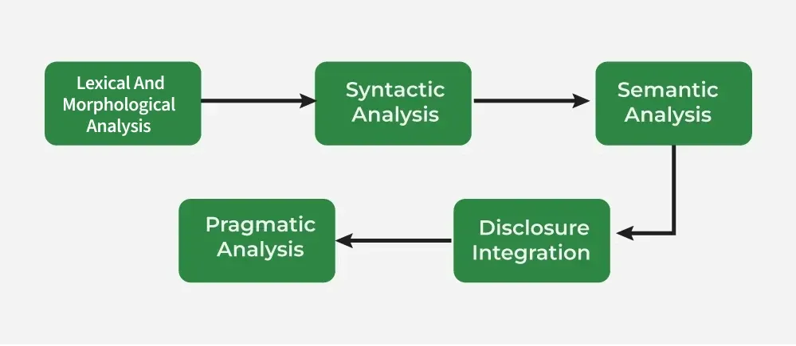
How Machines Process Language
NLP happens in phases - today's session lives in the very first one
Image: GeeksforGeeks - Phases of NLP
Lexical & morphological analysis = tokenization, stemming, lemmatization - exactly what we learn today.
Session 19 · NLP Fundamentals
4

Slide 5
Why is Text Hard for Computers?
Images are already numbers (pixels). Text is not - and language is messy:
Ambiguity
“I saw the bank” - river bank or money bank?
Same idea, many forms
run, runs, running, ran - one concept, four words
Word order matters
“Dog bites man” ≠ “Man bites dog”
Typos & variation
gr8, coooool, recieve - humans cope, machines struggle
Solution: a text processing pipeline that cleans and standardizes text before any model sees it.
Session 19 · NLP Fundamentals
5

Slide 6
The Text Processing Pipeline
Every step turns messy human text into clean machine-ready units
1
2
3
Raw Text
Cleaning
Tokenization
“The cats are running!”
lowercase, remove punctuation
[the, cats, are, running]
6
5
4
To Numbers
Stem / Lemmatize
Stop Word Removal
[512, 87] - token IDs
[cat, run]
[cats, running]
Today's theory covers steps 2-5; the notebook makes you run the whole pipeline yourself.
Session 19 · NLP Fundamentals
6

Slide 7
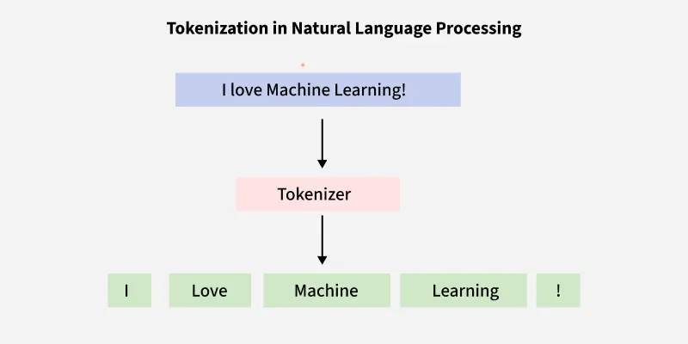
Tokens & Tokenization
Token: the smallest unit of text a model works with - a word, a piece of a word, or a character.
Tokenization: the process of splitting raw text into tokens. It is the first real step of every NLP system.
Example
“I love computer vision”
Image: GeeksforGeeks - Tokenization in NLP
I
love
computer
vision
Why it matters: every later step (vocabulary, embeddings, transformers) operates on tokens, not raw text.
4 word tokens
Session 19 · NLP Fundamentals
7

Slide 8
Words vs Subwords vs Characters
Three ways to split the same word: “unhappiness”
Word-level
Subword-level
Character-level
unhappiness
un
happi
ness
u
n
h
a
p
...
+ Intuitive, short sequences
– Huge vocabulary; unknown words break it
+ Small vocab + handles new words
– Splits are learned, not linguistic
+ Tiny vocab, never out-of-vocabulary
– Very long sequences; characters carry little meaning
Classic NLP (NLTK, bag-of-words)
Modern LLMs: BERT, GPT (BPE, WordPiece)
Spelling correction, some languages
Session 19 · NLP Fundamentals
8

Slide 9
Subwords in Practice
How GPT & BERT read words they have never seen - the trick behind every modern language model
Frequent words stay whole; rare words get split into familiar pieces.
So the model can read words it has never seen before - no “unknown word” problem.
BERT (WordPiece):
“tokenization” →
token
##ization
“##” means: this piece continues the previous one
Common subword algorithms:
BPE (Byte-Pair Encoding) - GPT models. Repeatedly merges the most frequent character pairs.
WordPiece - BERT. Similar idea, picks merges that maximize likelihood.
SentencePiece - T5, LLaMA. Works on raw text, language-independent.
Session 19 · NLP Fundamentals
9

Slide 10
Vocabulary: The Model's Dictionary
The vocabulary is the fixed set of all tokens a model knows. Each token gets a unique ID number - and these IDs are what the model actually receives.
token → ID
[PAD]
0
[UNK]
1
Size trade-off
Bigger vocab → shorter sequences, more memory. Smaller vocab → longer sequences, less memory.
Out-of-Vocabulary (OOV)
A word not in the vocabulary becomes [UNK] (unknown) - information is lost. Subwords largely solve this.
Typical sizes
BERT ≈ 30k tokens · GPT-2 ≈ 50k tokens
the
2
cat
3
run
4
vision
5
Special tokens: [PAD] fills space, [UNK] = unknown, [CLS]/[SEP] mark sentences (BERT).
Session 19 · NLP Fundamentals
10

Slide 11
Stop Words: Filtering the Noise
Stop words are very common words that carry little meaning on their own - articles, prepositions, pronouns.
the
is
a
an
in
of
to
and
it
was
for
on
Before:
“The quick brown fox jumps over the lazy dog”
After:
[quick, brown, fox, jumps, lazy, dog]
Remove them for:
Text classification, search, keyword extraction, topic modeling
Keep them for:
Translation, chatbots, LLMs - “not good” ≠ “good”!
Session 19 · NLP Fundamentals
11

Slide 12
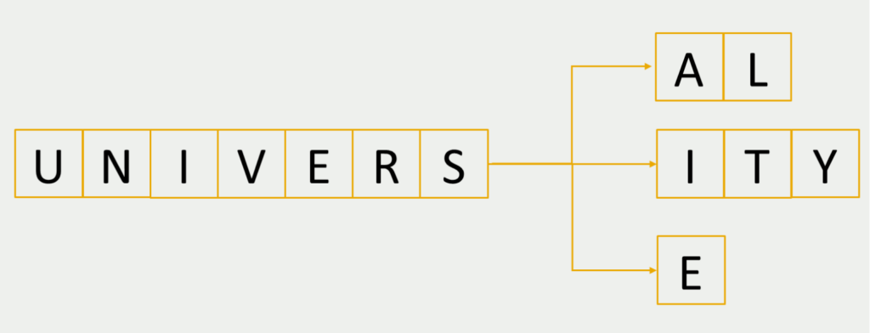
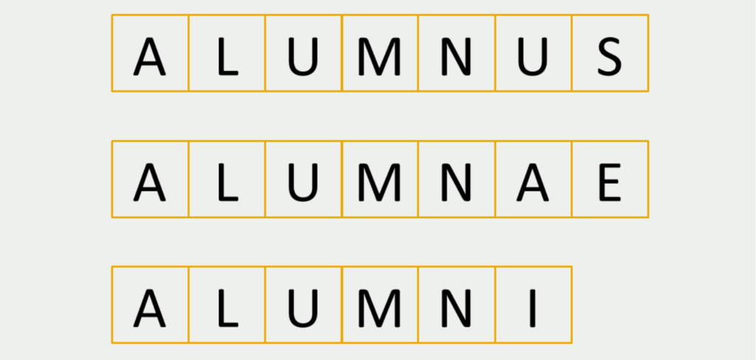
Stemming: Chopping Words to Their Root
Stemming cuts off word endings using simple rules to reach a common “stem”. Fast and crude - the result may not be a real word.
Pitfalls
Porter Stemmer examples
running, runs, ran*
→
run / ran
Over-stemming: unrelated words collapse together
studies, studying
→
studi (not a word!)
likes, likely, liked
→
like
history, historical
→
histori
* irregular forms are NOT handled - stemming has no dictionary
Why use it? Search engines: a query for “fishing” should also match “fish” and “fished”. Speed matters more than perfect grammar.
Under-stemming: related words stay separate
Images: Data Basecamp (databasecamp.de)
Session 19 · NLP Fundamentals
12

Slide 13
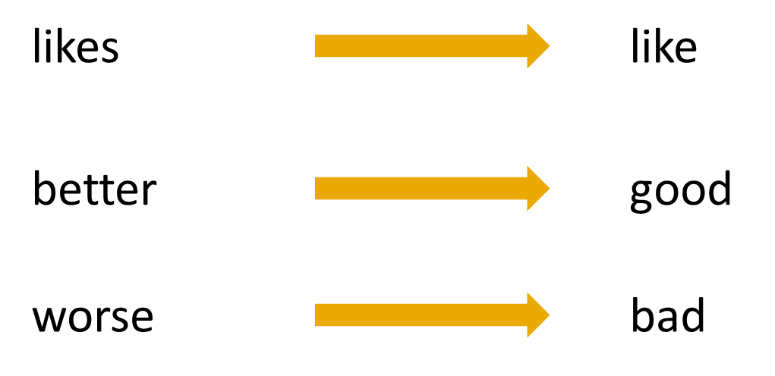
Lemmatization: The Smart Alternative
Lemmatization reduces a word to its dictionary form (the “lemma”) using vocabulary and grammar - the output is always a real word.
Examples (WordNet lemmatizer)
studies
→
study
better (adjective)
→
good
ran
→
run
mice
→
mouse
Image: Data Basecamp - lemmatization maps words to real dictionary forms
The catch: it needs to know the part of speech (“better” as adjective → good; as adverb → well) and is slower than stemming.
Session 19 · NLP Fundamentals
13

Slide 14
Stemming vs Lemmatization
Stemming
Lemmatization
Method
Rule-based suffix chopping
Dictionary + grammar analysis
Output
May be a non-word (“studi”)
Always a real word (“study”)
Speed
Very fast
Slower
Context aware?
No
Yes (uses part of speech)
Best for
Search engines, quick filtering
Chatbots, analysis needing meaning
Rule of thumb: need speed → stem · need meaning → lemmatize · modern LLMs → subwords
Session 19 · NLP Fundamentals
14

Slide 15
N-grams: Capturing Word Order
An n-gram is a sequence of n consecutive tokens. Single tokens lose word order - n-grams bring some of it back.
“I love natural language processing”
Unigrams (n=1)
I
love
natural
language
processing
Bigrams (n=2)
I love
love natural
natural language
language processing
Trigrams (n=3)
I love natural
love natural language
natural language processing
Where n-grams shine: autocomplete (“new york → city”), language models before deep learning, text features for classifiers (“not good” as one unit fixes the stop-word problem!)
Session 19 · NLP Fundamentals
15

Slide 16
Putting It All Together
One sentence through the whole pipeline
Raw text
“The striped cats were running quickly!”
Lowercase + clean
the striped cats were running quickly
Tokenize
[the, striped, cats, were, running, quickly]
Remove stop words
[striped, cats, running, quickly]
Lemmatize
[striped, cat, run, quickly]
Token IDs
[1042, 87, 314, 905] → ready for a model
Session 19 · NLP Fundamentals
16

Slide 17
Recap & What's Next
Tokenization - splitting text into words, subwords, or characters
Vocabulary - the model's dictionary - tokens mapped to IDs
Stop words - common low-meaning words; remove with care
Stemming vs Lemmatization - fast chopping vs dictionary-correct base forms
N-grams - consecutive token sequences that capture word order
Now: hands-on notebook
Tokenize real text with NLTK, remove stop words, compare stemming vs lemmatization, build n-grams - and peek at a real BERT tokenizer.

